Slide 1
MINDFULNESS-BASED
STRESS REDUCTION:
POWER OF THE PRACTICE
ALI TURFE, SCHOOL PSYCHOLOGIST, LLP
CERTIFIED MBSR TEACHER
BROWN UNIVERSITY
Notes:
Phones on silence or vibrate;

Slide 2
Full Disclosure Statement
No conflict of interest exists
Not supported financially by any manufacturer of any commercial product
I will not gain anything financially by the sale of any product or publication as a result of this workshop
None of the research presented has been funded by external sources

Slide 3
NASP Practice Model (NASP, 2020)
Duty to have ethical knowledge to facilitate effective practice (NASP, 2020)
To support our students’ wellness most effectively, it is important we practice our own self-care

Slide 4
Credentials
Master’s Degree Education: Michigan State University
Specialist Degree School Psychology: University Detroit/Mercy
Michigan Certified School Psychologist
Detroit Public Schools Community District 22 years
Worked in public education since 1993

Slide 5
Credentials
Mindfulness Practitioner
Mindfulness Center at Brown University
Taught 41 eight-week cycles MBSR
Certified 500 participants in MBSR
Attended 6 retreats each five-seven days long

Slide 6
How to develop a practice?

Slide 7
OPENING PRACTICE

Slide 8
What is your name?
Where are you from?
What did you notice in this opening practice?

Slide 9
MBSR
Mindfulness goes further than SEL in that it creates the foundational awareness necessary to access the cognitive skills necessary for acquiring social and emotional learning
Self-Care

Slide 10
MINDFULNESS IS
EVIDENCE BASED

Slide 11
MINDFULNESS BASED STRESS REDUCTION MBSR
JON KABAT-ZINN 1980s
UNIVERSITY OF MASSACHUSETT GENERAL HOSPITAL
Notes:
More than 100 members of British Parliament trained in MBSR, Mindfulness training center established in Parliament building. Legislation passed Mindfulness education in all public school

Slide 12
MBSR
Gold standard in the world for mindfulness training
More peer reviewed articles published in professional journals on MBSR than any mindfulness training program in the world
More than 6000 articles reference the benefits of MBSR
More than 40 years of empirical evidence
Used in more than 1000 hospitals worldwide
Mindfulness is time-tested 2600 years

Slide 13
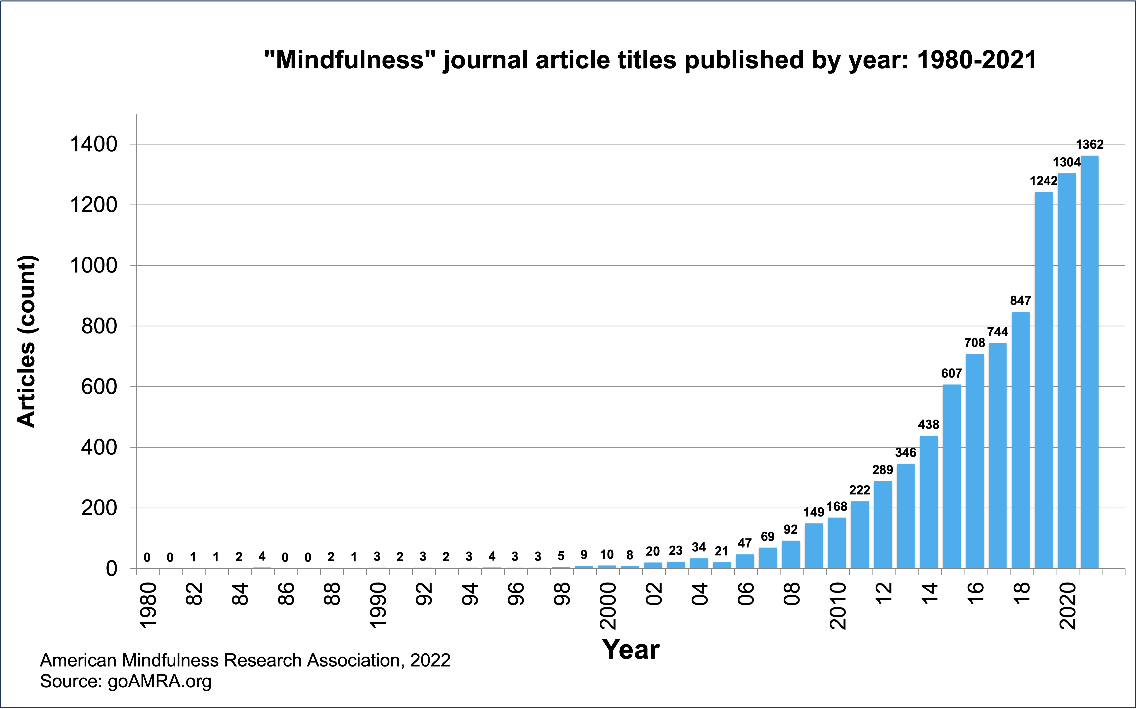

Slide 14
MINDFULNESS FUNDAMENTALS
SAFE
NURTURING
SUPPORTIVE
ACCEPTANCE
ATTENDING TO YOUR NEEDS
CONFIDENTIALITY
NON-JUDGEMENTAL ZONE
NO ADVICE GIVING
NO NEED TO FIX ONE ANOTHER
I STATEMENTS
SPACIOUS LISTENING
MINDFUL SPEAKING

Slide 15
SITTING MEDITATION

Slide 16
WHAT ARE YOU EXPERIENCING?
HEARING?
SEEING?
FEELING?
SMELLING?
TASTING?
THINKING?
RIGHT NOW?
Notes:
Hearing knowing I am hearing
Seeing knowing I am seeing
Feeling knowing I am feeling
Smelling knowing I am smelling
Tasting knowing I am tasting
Thinking knowing I am thinking

Slide 17
What did you notice?
In the
-Body?
-Mind?
-Environment?
What came up?
Notes:
What challenges came up?

Slide 18
SHARING
INQUIRY

Slide 19
MINDFUL EATING PRACTICE

Slide 20
MINDFUL MOVEMENT PRACTICE

Slide 21
What did you notice?
In the
-Body?
-Mind?
-Environment?
What came up?
Notes:
What challenges came up?

Slide 22
SHARING
INQUIRY

Slide 23
COMMUNICATION PRACTICES
PAUSE
TWO FEET ONE BREATH
STOP PRACTICE

Slide 24
STOP
S= Stop or Pause
T= Take a breath or two/Tune into sensations
O= Observe your experience, observe an anchor, open to experience
P= Proceed, now you have choice

Slide 25
What did you notice?
In the
-Body?
-Mind?
-Environment?
What came up?
Notes:
What challenges came up?

Slide 26
SHARING
INQUIRY

Slide 27
LOVING KINDNESS PRACTICE

Slide 28
What did you notice?
In the
-Body?
-Mind?
-Environment?
What came up?
Notes:
What challenges came up?

Slide 29
SHARING
INQUIRY

Slide 30
DEFINITION OF MINDFULNESS
Paying attention in a particular way:
On purpose
In the present moment
Nonjudgmentally
Jon Kabat-Zinn

Slide 31
“Mindfulness is about being fully awake in our lives.
It is about perceiving the exquisite vividness of each moment.
We feel more alive.
We also gain immediate access to our own
powerful inner resources for insight, transformation and
healing.”
~Jon Kabat-Zinn

Slide 32
MINDFULNESS
IS
ALL
ABOUT
THE
PRACTICE

Slide 33
MINDFULNESS
MUST
BE
EXPERIENCED
TO
BE
KNOWN

Slide 34
Power of Observation
Change happens through observation
Notes:
"Where observation is concerned, chance favors the prepared mind" (Louis Pasteur)

Slide 35
GETTING
OUT OF
THE HEAD
AND
EXPLORING
THE BODY

Slide 36
Mindfulness Key Studies
Improvements in Immune System and Brain, Davidson, et.al 2003
Increased cortical thickness, (introspection and attention), Lazar, et.al, 2009
Increase in gray matter, Holzel, et.al, 2001
Decrease in cellular aging and disease (telemoeres), Epel, et.al, 2009
Nothing strengthens frontal lobe and executive functions more than mindfulness meditation, McClosky, 2020
goAmRA.org for additional research
Notes:
Cortical-outer layer of brain or cerebrum, involved in higher processing of information
Gray Matter-intelligence, information processing, the darker tissue of the brain and spinal cord, consisting mainly of nerve cell bodies and branching dendrites
Telemores-compound structure at the end of the chromosome, over time they become shorter

Slide 37
IMPACT ON MENTAL AND PHYSICAL WELL-BEING
ANXIETY
DEPRESSION
STRESS REDUCTION
HAPPINESS
REDUCTION IN RUMINATION, WORRY AND SELF-CRITICISM
INCREASES COMPASSION
DECREASES NON CONSTRUCTIVE HABITS AND SUPPORTS DEVELOPMENT OF MORE CONSTRUCTIVE ONES
ADDICTION
SYMPTOMS OF BURN-OUT-exhaustion, disconnection
Gross et al. 2004 J Psychosomatic Research 57:35-43; Khoury et al. 2013. Clin. Psychol Rev 33:763-71; Segal et al. 2010 Arch n Psychiatry 67 1256-64; Rowen et al. 2014 JAMA Psychiatry 71 547-556; Goval M et al. 20`4 JAMA intern Med 174:357-368

Slide 38
Start a Mindfulness Practice
One Breath
Two Feet

Slide 39
FORMAL PRACTICES
BODY SCAN
SITTING MEDITATION
MINDFUL MOVEMENT YOGA
KINDNESS/FRIENDLINESS

Slide 40
INFORMAL PRACTICES
What’s Happening Now
Intentionally attending to daily experiences

Slide 41
MEDITATION IS TO MINDFULNESS
AS EXERCISE IS TO FITTNESS

Slide 42
MINDFULNESS PRACTICE
The core of the task: getting people to inhabit the present moment in a state of being.
People have been trying to protect themselves from stress, anxiety, fears and worries: they need instead to cultivate an accepting, letting go, non-judgmental, and compassionate attitude.
Helping people learn how to cultivate presence, awareness, and connectivity through formal and informal practices.
Notes:
We are human beings. Do from a state of being. Being: the nature or essence of a person, the qualities that constitute an existent thing, presence, living, reality,

Slide 43
“Between stimulus and response there is a space.
In that space is our power to choose our response.
In our response lies our growth and our freedom.”
-Victor Frankl

Slide 44
The Guest House
This being human is a guest-house. Every moment a new arrival.
A joy, a depression, a meanness, some momentary awareness comes as an unexpected visitor.
Welcome and entertain them all! Even if they're a crowd of sorrows, Who violently sweep your house empty of its furniture.
still, treat each guest honorably. He may be clearing you out for some new delight.
The dark thought, the shame, the malice, meet them at the door laughing, and invite them in.
Be grateful for whoever comes, because each has been sent as a guide from within
-- Jelaluddin Rumi translation by Coleman Barks
Notes:
Read the poem during the practice. Do not close the practice until I read the poem.

Slide 45
Love After Love- Derek Walcot
The time will come when, with elation you will greet yourself arriving at your own door, in your own mirror and each will smile at the other's welcome, and say, sit here. Eat. You will love again the stranger who was yourself. Give wine. Give bread. Give back your heart to itself, to the stranger who has loved you all your life, whom you ignored for another, who knows you by heart. Take down the love letters from the bookshelf, the photographs, the desperate notes, peel your own image from the mirror. Sit. Feast on your life.

Slide 46
Your history is here inside your body - Martha Elliot
Your history is here inside your body.
Your body is your storehouse
Of learnings, feelings, thoughts, and experiences.
Only waiting to be invited to reveal your treasures to yourself.
Help yourself.
As you let the learning emerge and take shape, you can
Appreciate the wisdom of the body.
Each cell alive with spirit, emotion, and intelligence.
Ready to help you at any moment,
always with you and for you.

Slide 47
I began this journey as a way of reducing stress and anxiety in my life. I knew it was a class focused on mindfulness practice, but really was not sure what to expect. I had a vision of learning how to bring awareness to myself, to my faults, and my weaknesses. I wanted to be able to overcome my fears, anxieties, and bad habits and build on my strengths. Each class brought a new level of awareness to who I was as a human being. My inner being grew stronger with each class and I looked forward to what the next class would bring to my inner peace, strength, and well-being. The class exceeded any expectations that I originally had. I feel I have grown and recognize a shift in mindset that will take me a long way. (School Psychologist)

Slide 48
The mindfulness course has been a life changer in a number of ways. Being able to bring awareness to myself during stressful times has allowed me to move away from the distorted thoughts and anxiety to a sense of calm and peace that helps me get through it. (School Social Worker)

Slide 49
I’ve learned that my mind has been all over the place (wandering) for so long and I don’t know how I got this way. It’s a subtle path to insanity/destruction. Mindfulness helps me be the person I’ve been desiring for years. I’ve been looking for my religious beliefs/practice to bring about this change. However, I’m finding more calmness, connection to something greater during the mindful practice. Blending mindfulness with my religious beliefs brings more fulfillment, than religion only. It feels like the missing piece. Up until this point, my religious practice has felt incomplete to me. It’s completed! (Army Captain)

Slide 50
Mindfulness/MBSR training has touched every area of my life.
I feel like a house undergoing renovations to be the most hospitable and beautiful and loving house possible. People like
coming over to this house to find space for themselves and to feel cared for. I can have boundaries in this house so that I have
sacred space, silence and time to play. (Speech Therapist)

Slide 51
I am becoming aware of my habitual habit of focusing on the past or either focusing on the future and not being present. I have asked myself what is in me that is uncomfortable with being here, being present and what am I running away from by putting so much thought and energy to thoughts about what has happened in the past and what is going to happen in the future as opposed to being present. (School Social Worker)

Slide 52
I am the only one who is not freaking out during the
end of the school year IEP rush.
(School Psychologist)

Slide 53
My mindfulness practice has been a godsend through these turbulent times. Thank you for spreading the practice. (School Social Worker)

Slide 54
MINDFULNESS RESOURCES HANDOUT
A. Mindfulness Practice Offered by Ali Turfe
1. Mindfulness Practice Guided Group Meditation
Monday-Friday 5:00am-5:30
Friday 8:30pm-9:00pm
2. Mindfulness Movement Practice
Saturday-Thursday 5:00-6:00pm
aliturfe429@gmail.com
B. Mindfulness Organization
Michigan Collaborative for Mindfulness in Education (MC4ME)
www. MC4ME.org
2. Ann Arbor Center for Mindfulness aacfm.org
3. Grand Rapids CFM grandrapidscenterformindfulness.com

Slide 55
MINDFULNESS RESOURCES HANDOUT
C. Create a daily habit with Insight Timer
1. Get the App from your App Store
2. Keep a record of your daily practice by
-Using the timer application to practice without a recording
-Enter the practices you do using Ruth’s recordings
-Do a daily 1-6 minute meditation by: Mark Williams, Tara Brach,
Bodhipaksa, Sharon Salzberg, Ruth Lerman
-Explore for other recordings that suit you
3. Watch your milestone- 1 for every 10 consecutive days of practice
D. Books
1. Full Catastrophe Living-Jon Kabat-Zinn
2. A Mindfulness-Based Reduction Workbook Bob Stahl PhD, Elisha Goldstein PhD comes with CD or web links to 21 online guided meditations
3. When Things Fall Apart-Pema Chodron
E. Podcasts:
1. Dan Harris is a fidgety, skeptical ABC newsman who had a panic attack live on Good Morning America, which led him to meditation. He wrote the bestselling book, “10% Happier,” and in the podcast, Dan talks with smart people about meditation
2. Ted Meissner: MBSR teacher interviews scientists, teachers and mindfulness practitioners https://presentmomentmindfulness.com/category/podcast. He also offers an online MBSR course and wealth of resources on his website https://presentmomentmindfulness.com/

Slide 56
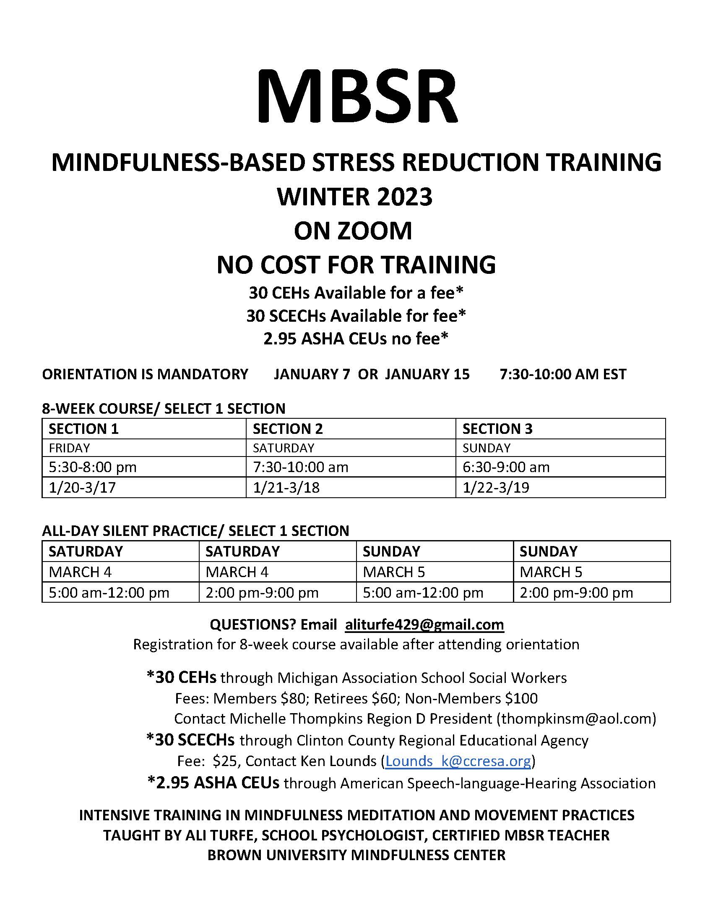

Slide 57
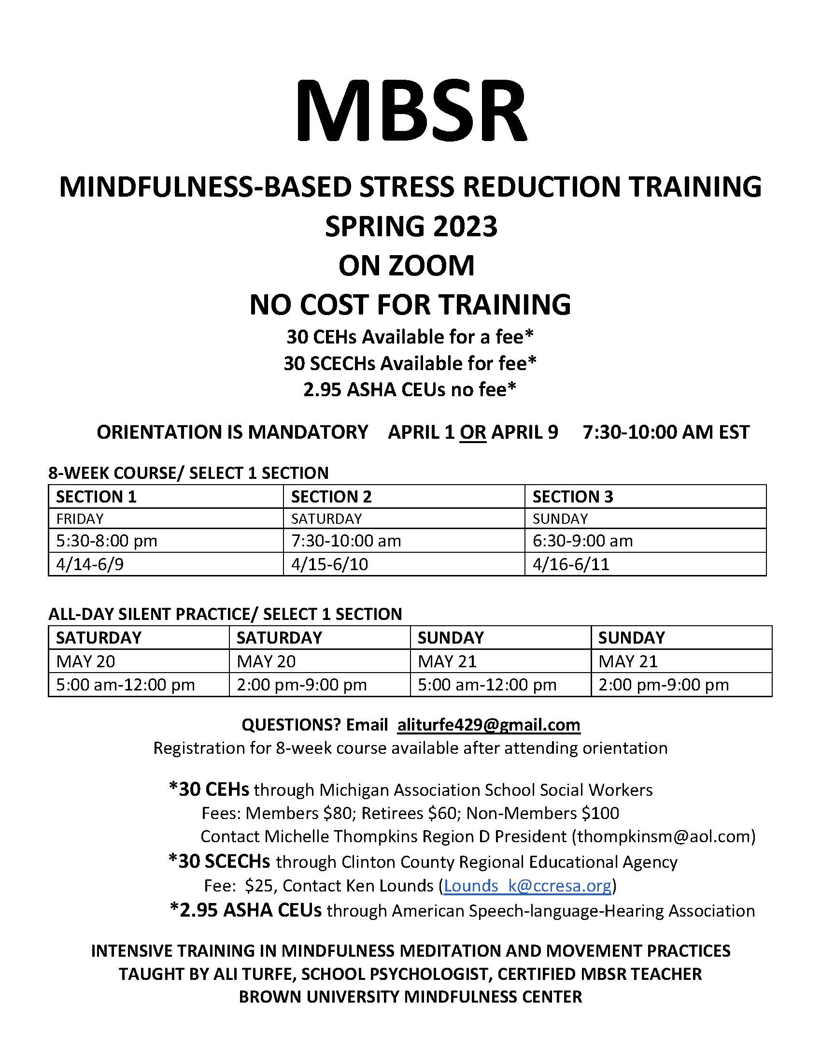

Slide 58
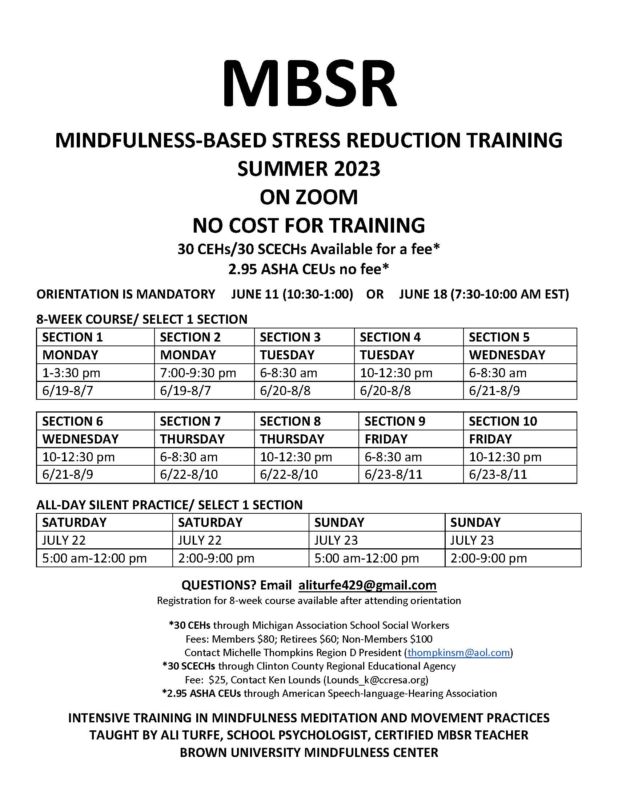

Slide 59
CONTACT INFORMATION
ALI TURFE, SCHOOL PSYCHOLOGIST, LLP
ALITURFE429@GMAIL.COM
313.378.8886

Slide 60
CLOSING PRACTICE

